Slide 1


Slide 2




Slide 3
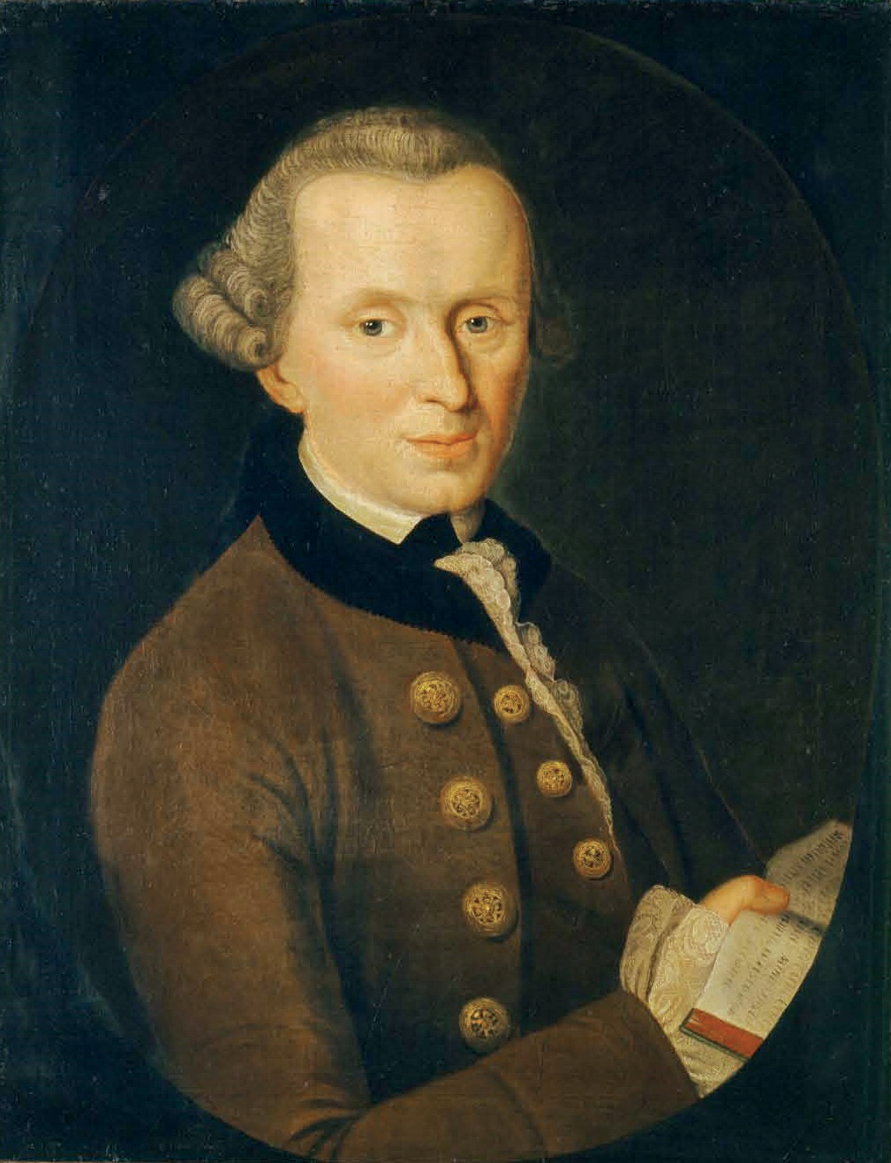
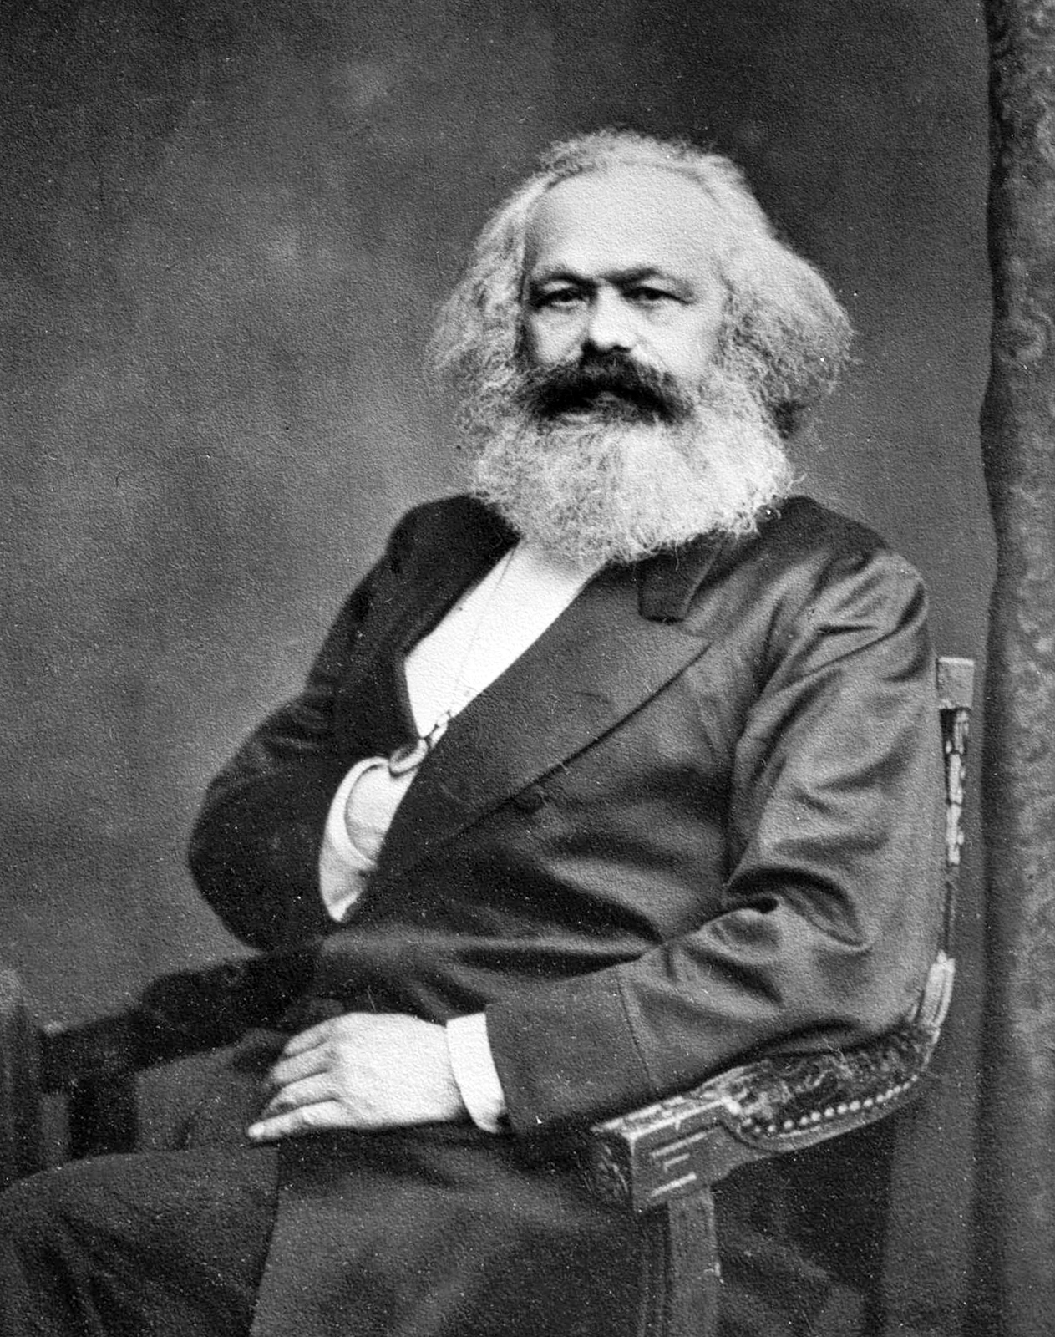
Immanuel Kant
1724—1804
Karl Marx
1818—1883
Notes:
Kant: painting by Johann Gottlieb Becker
Marx: photo by John Mayall

Slide 4
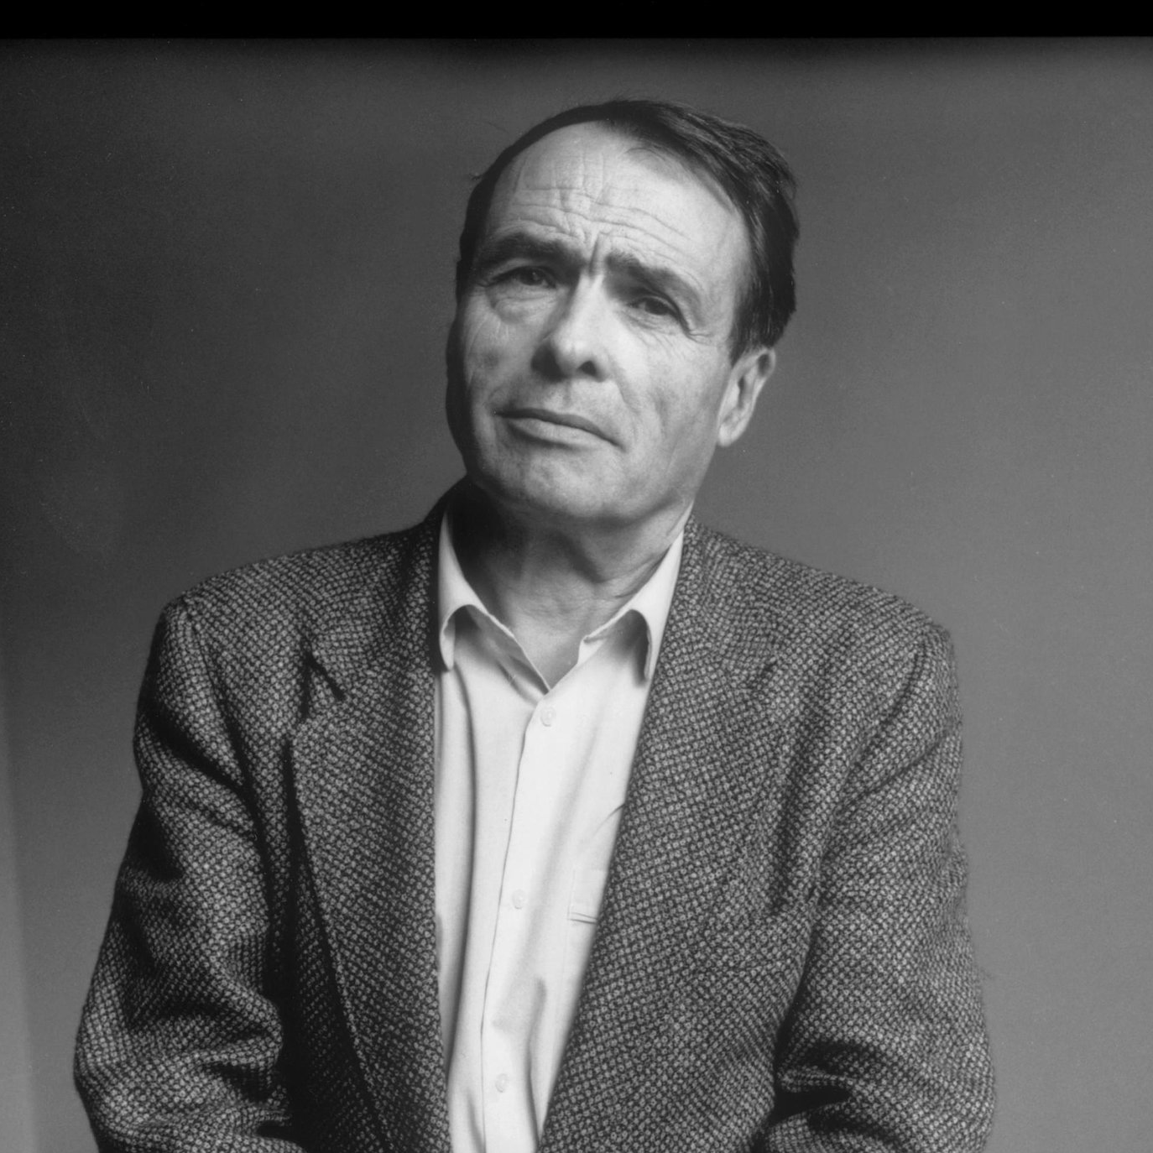
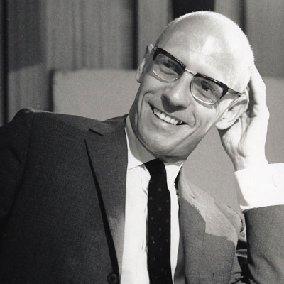
Pierre Bourdieu
1930—2002
Michel Foucault
1926—1984
Notes:
Bourdieu image source: https://www.nytimes.com/2017/07/18/opinion/inequality-pierre-bourdieu.html
Foucault image source: https://contemporarythinkers.org/michel-foucault/biography/

Slide 5
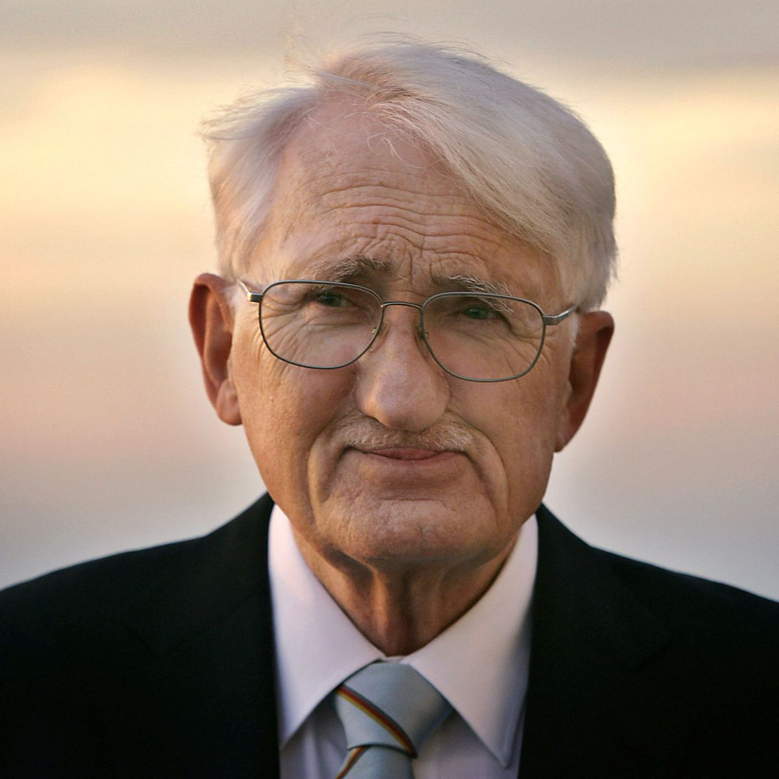
Jürgen Habermas
b. 1929
Notes:
https://www.spiegel.de/international/europe/habermas-the-last-european-a-philosopher-s-mission-to-save-the-eu-a-799237.html

Slide 6



Slide 7
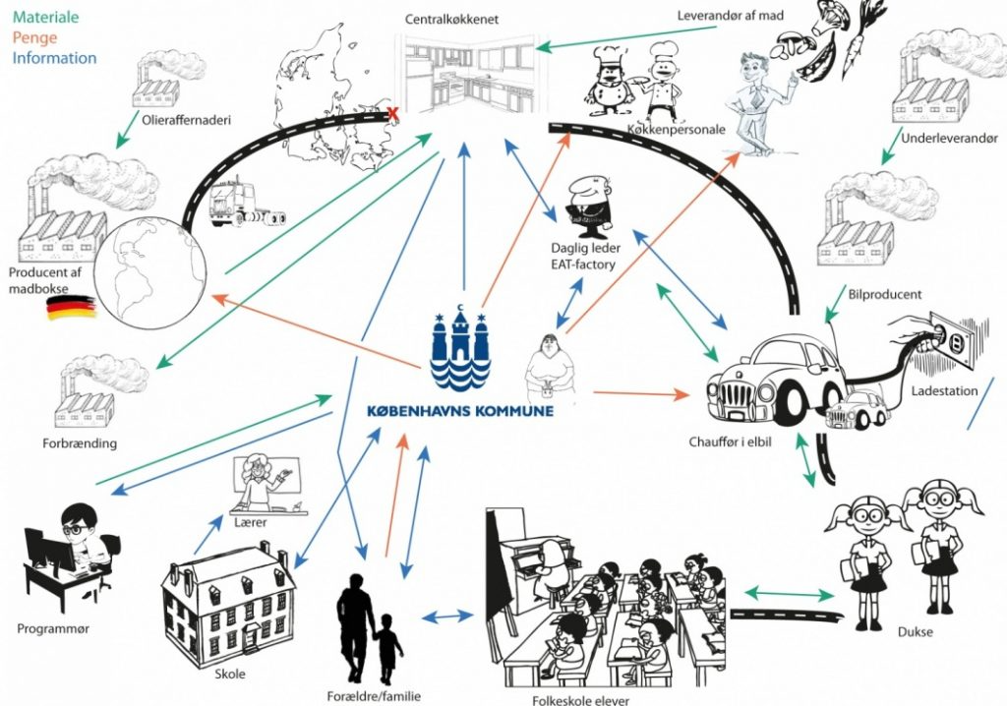

Slide 8
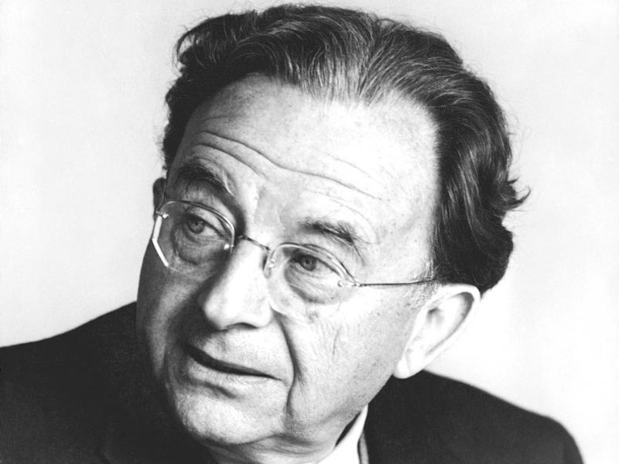
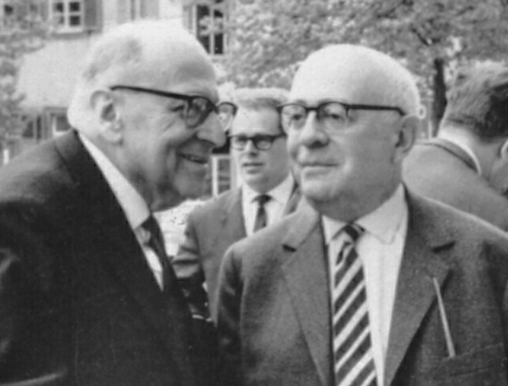
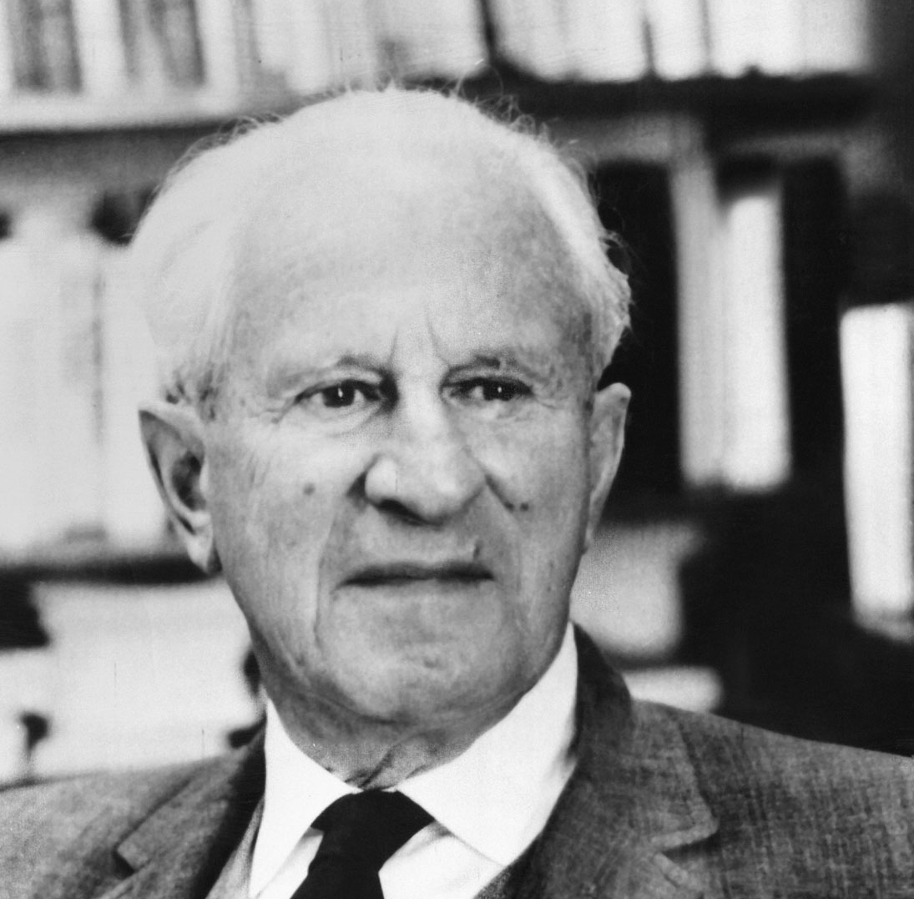
Erich Fromm 1900—1980
Max Horkheimer 1895—1973
Theodor Adorno 1903—1969
Herbert Marcuse 1898—1979

Slide 9
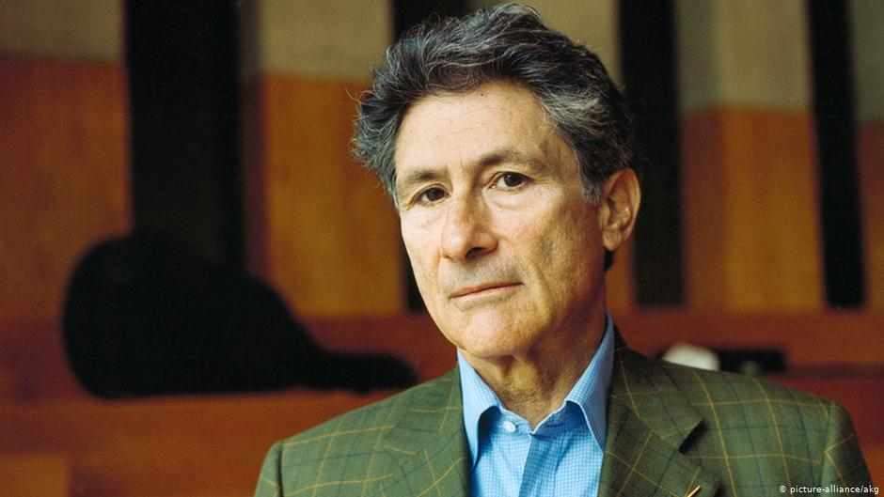
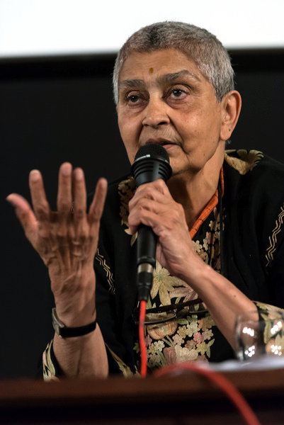
Edward W. Said
1935—2003
Gayatri C. Spivak
b. 1942
Homi K. Bhabha
b. 1949

Slide 10



